Slide 1
2024-03-13: SEM-06, reproducibility test
Gottfrid Olsson
Samples: V, X, Y, Z

Slide 2
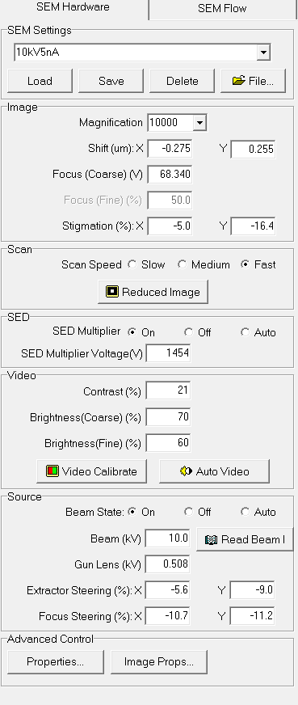

Slide 3
Sample X

Slide 4
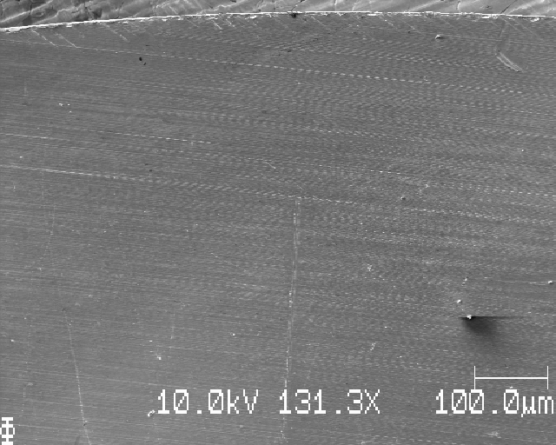
At edge

Slide 5
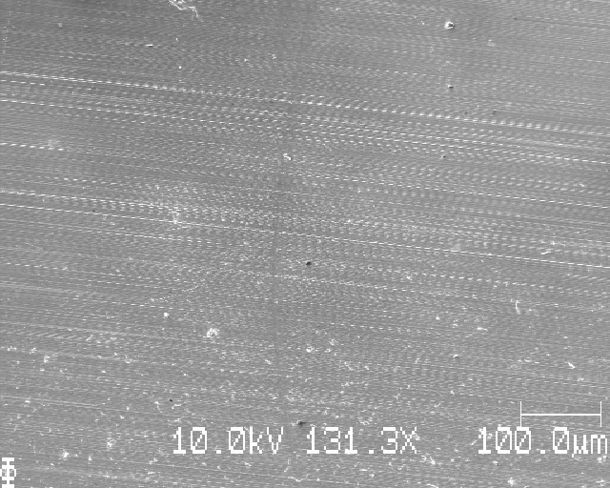
Start seeing depositoin

Slide 6
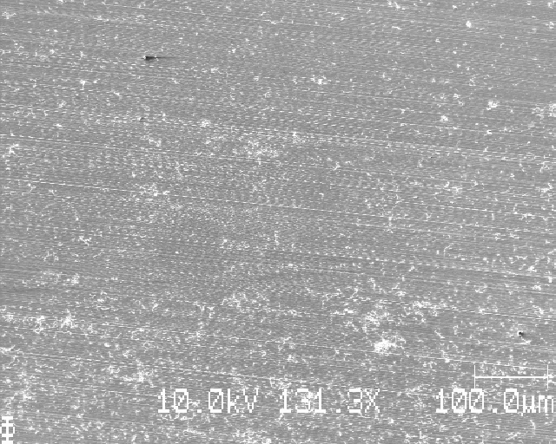
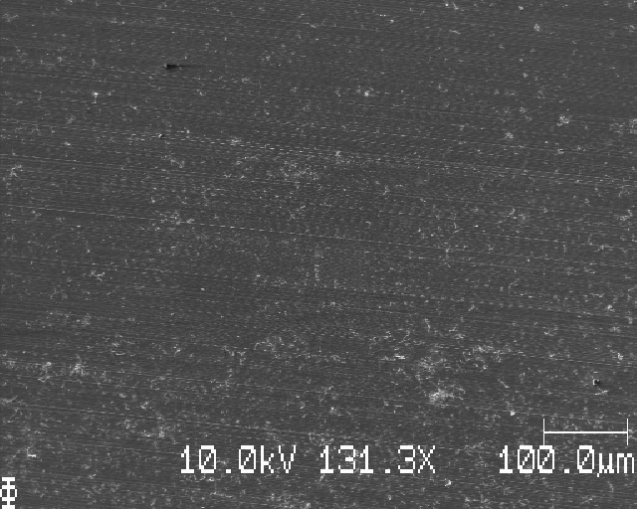
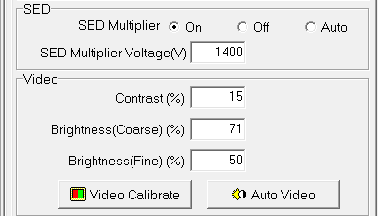
Start of deposition, different contrast/brightness/SEDMultiplierV

Slide 7
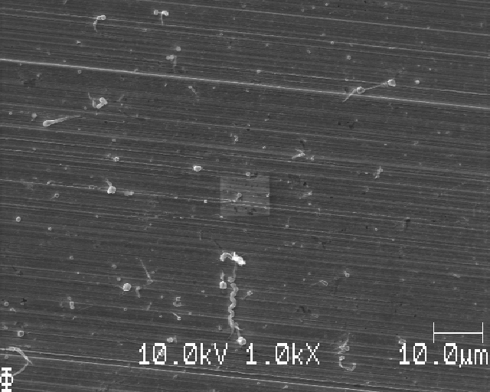

Slide 8
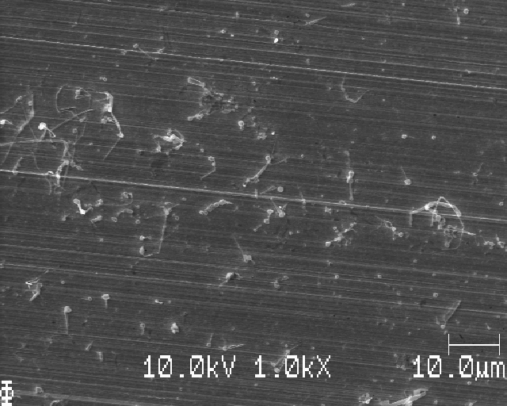
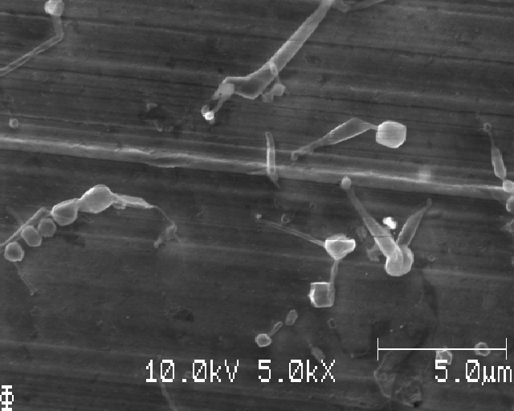

Slide 9
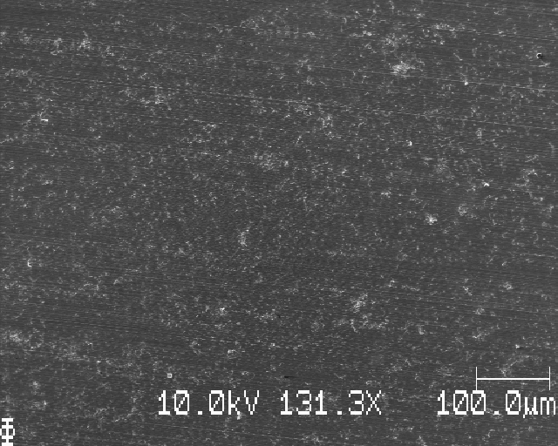
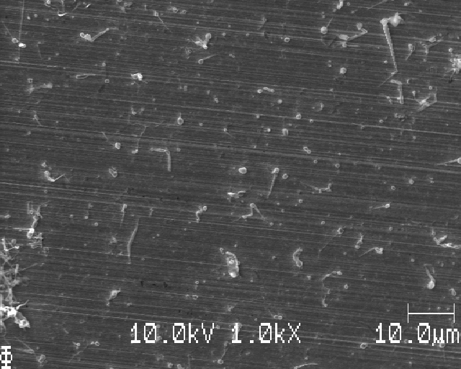
About 1 mm downwards

Slide 10
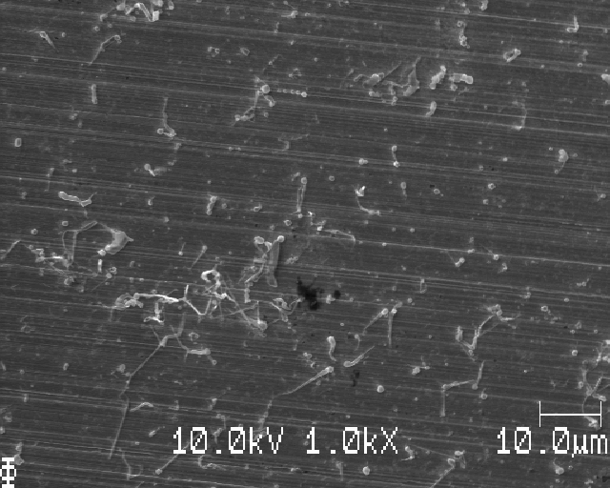
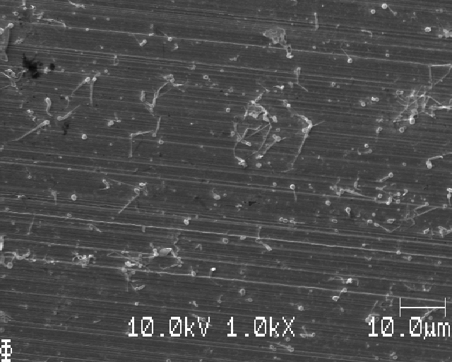
Different places, different magnifications

Slide 11
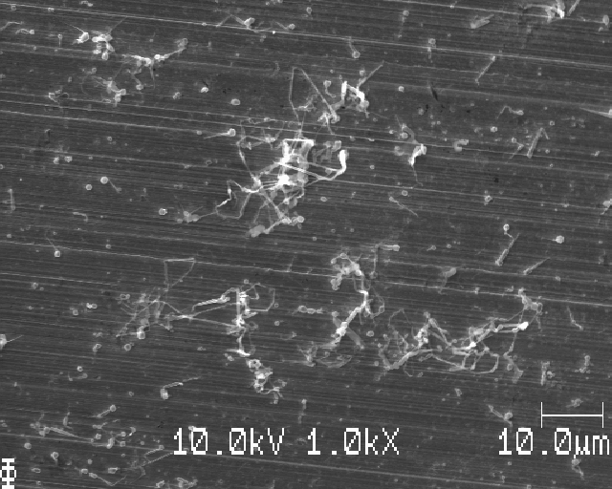
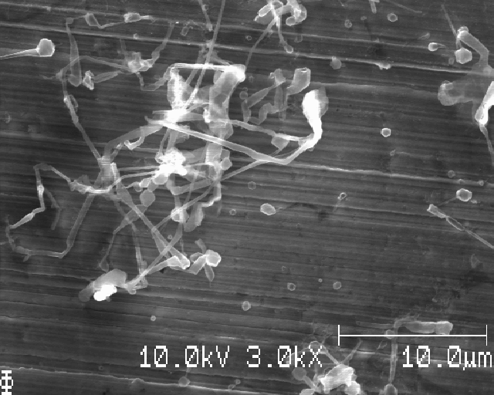

Slide 12
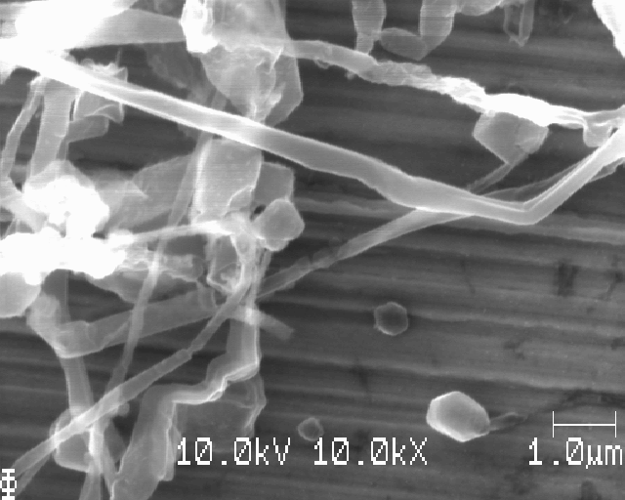
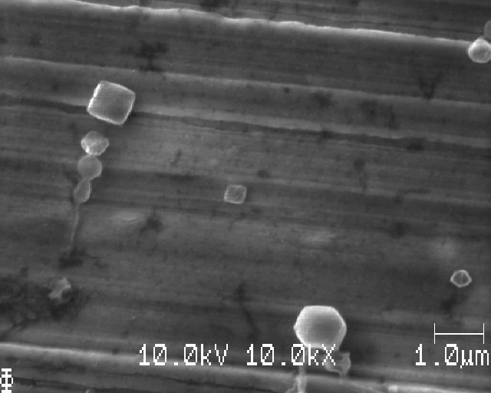

Slide 13
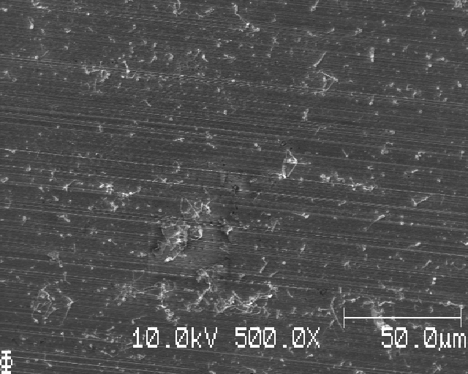
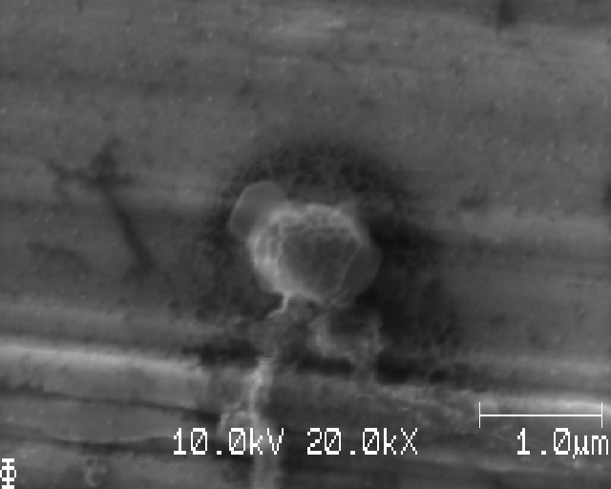

Slide 14
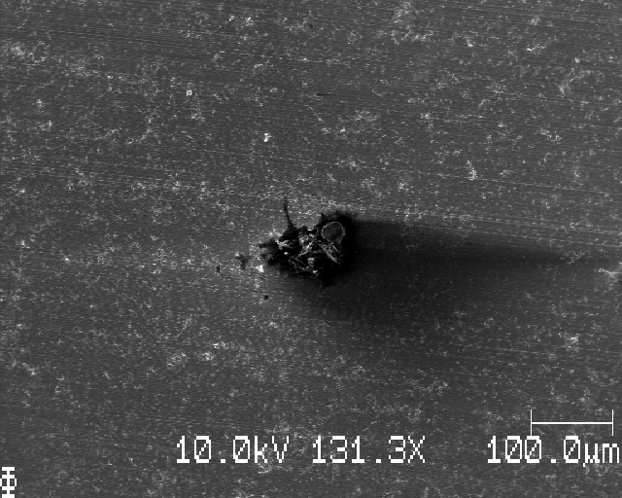
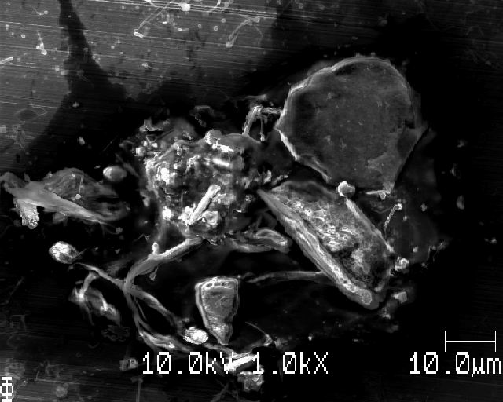
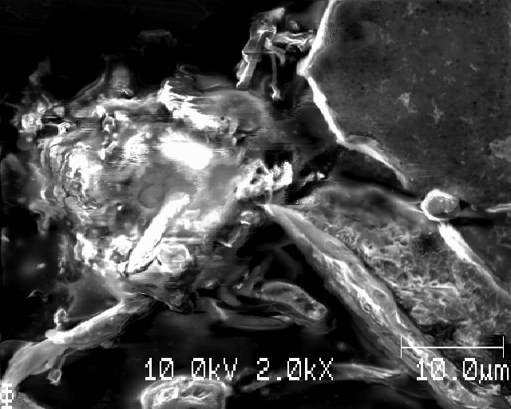
Stor skrap? Might be from pushing down the Cu on the Cu tejp using the pincer

Slide 15
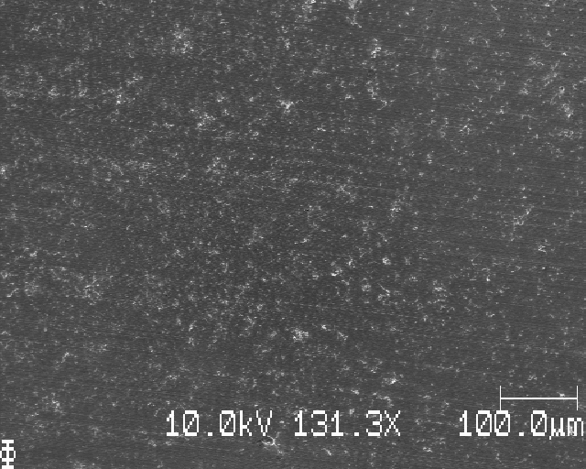
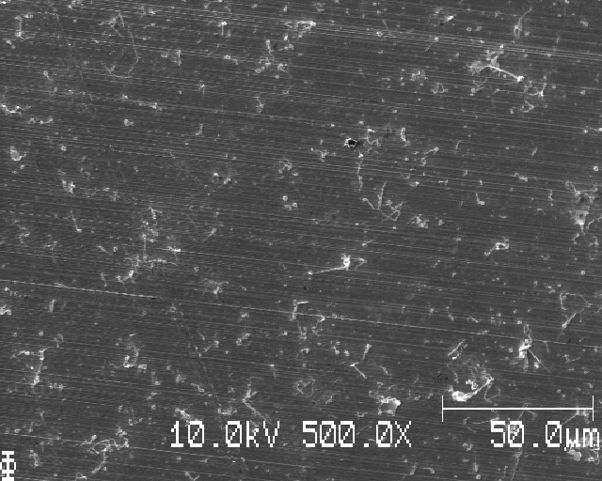
Further down

Slide 16
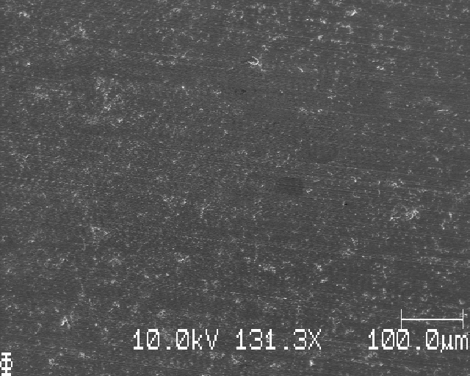
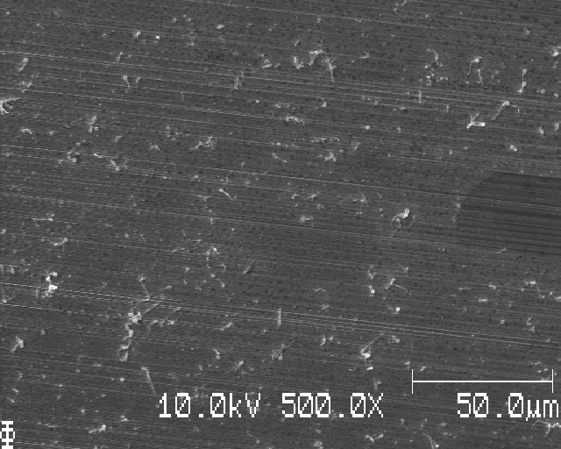
Even further down

Slide 17
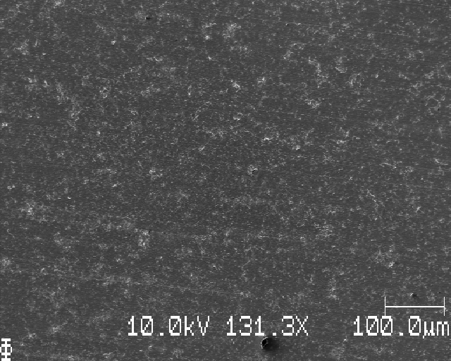
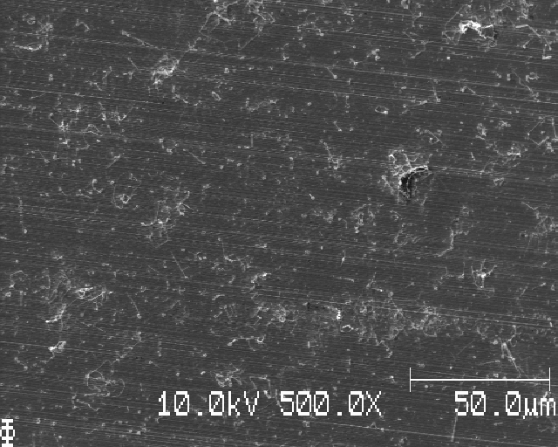
Still further down

Slide 18
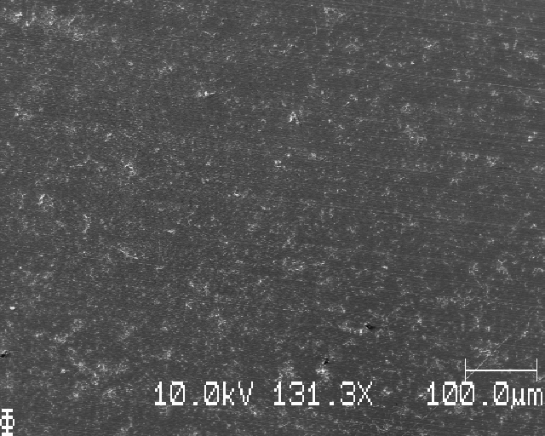
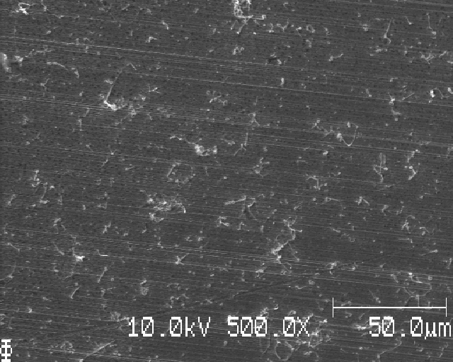
Yet further down

Slide 19
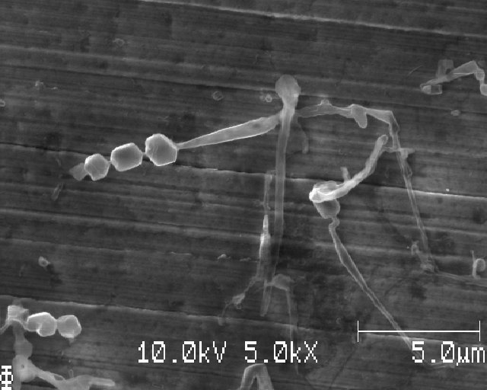

Slide 20
Auger test

Slide 21
Point 1 and 2

Slide 22
Point 3 and 4

Slide 23
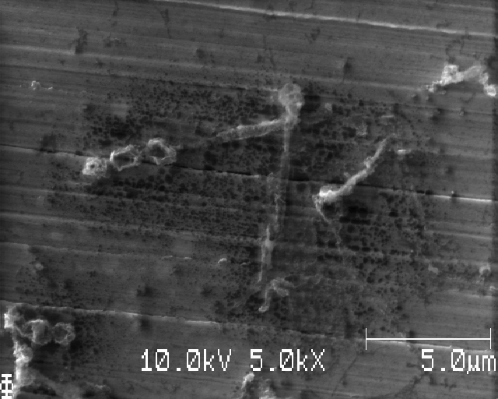
Same place after looking at it for many minutes

Slide 24
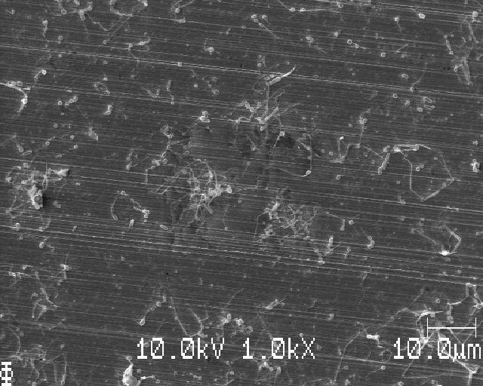
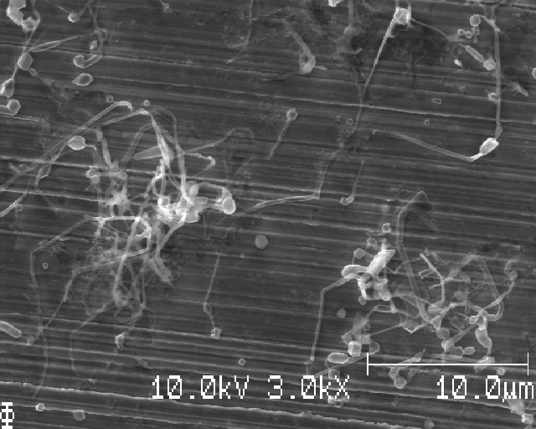

Slide 25
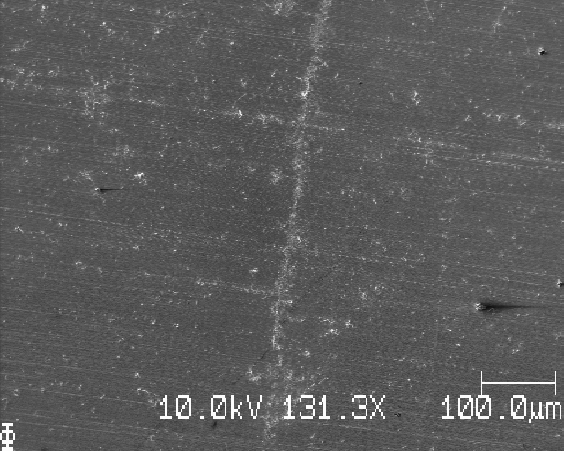
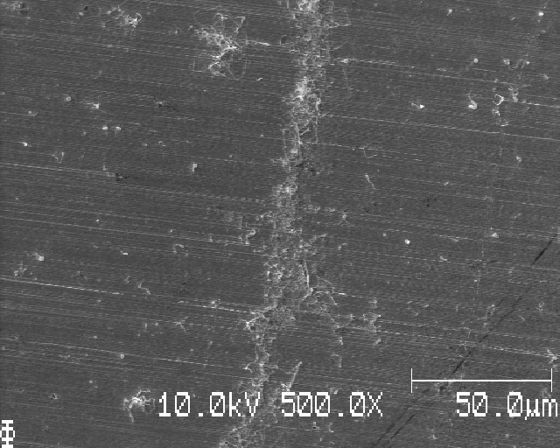
More deposition in crack/crevasse?

Slide 26
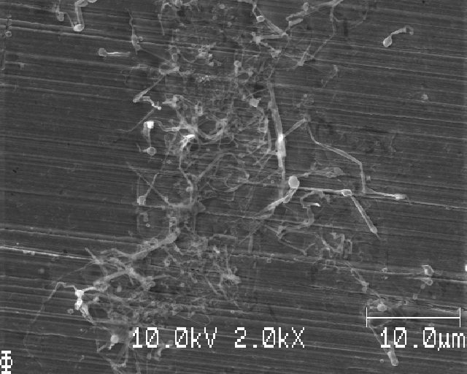
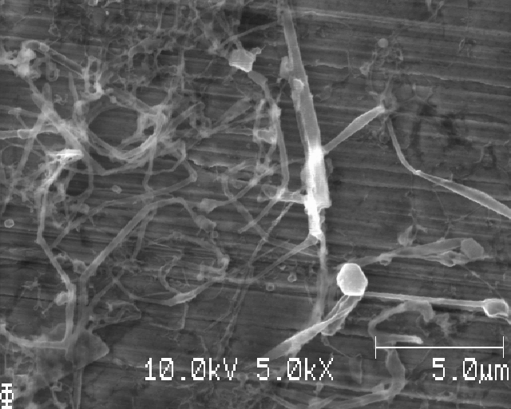

Slide 27
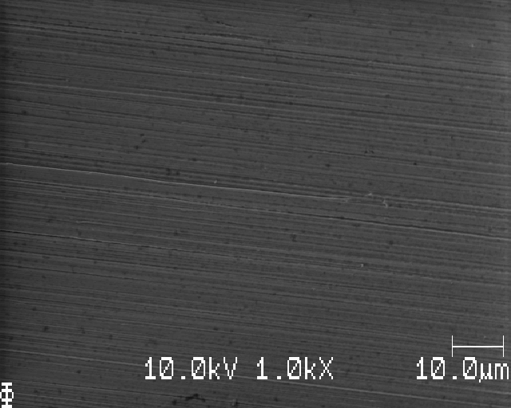
Auger on bare Cu (close to edge of sample)

Slide 28
Point 1 and 2 (bare Cu, no Li)

Slide 30
Sample V (same build and cycling as sample X and Y)

Slide 31
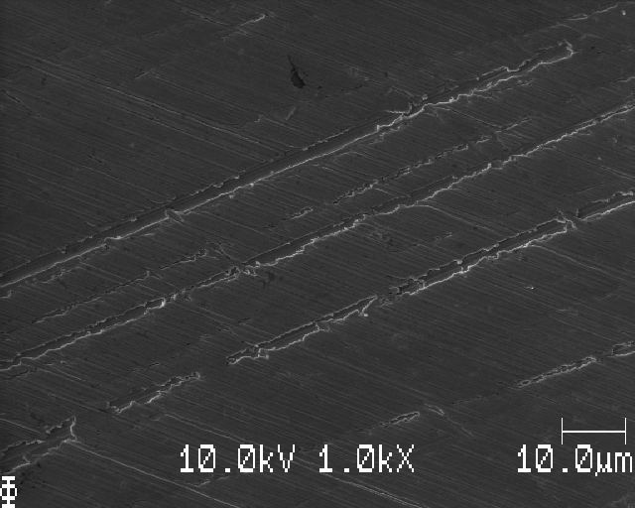
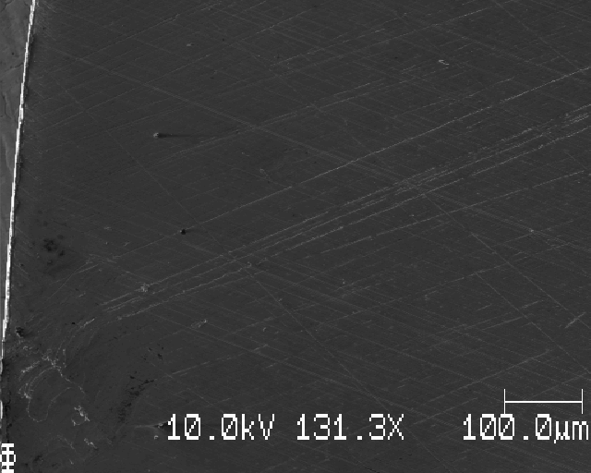
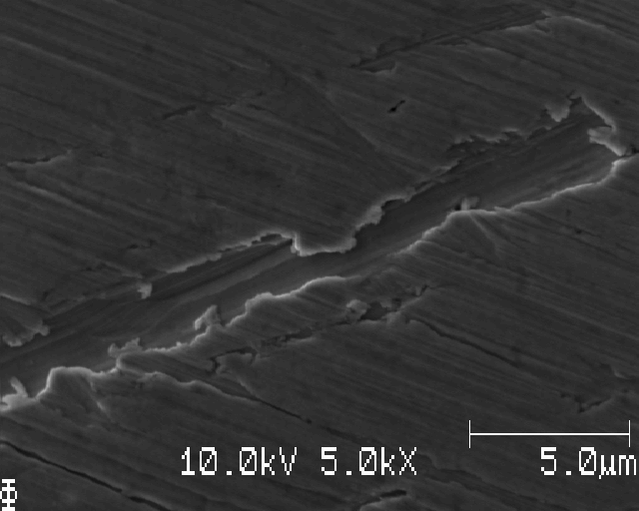
Edge, scratches

Slide 32
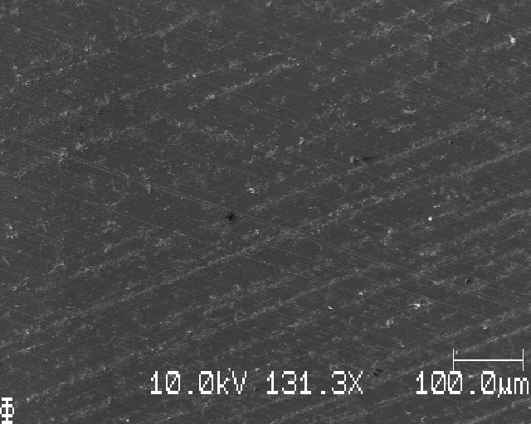
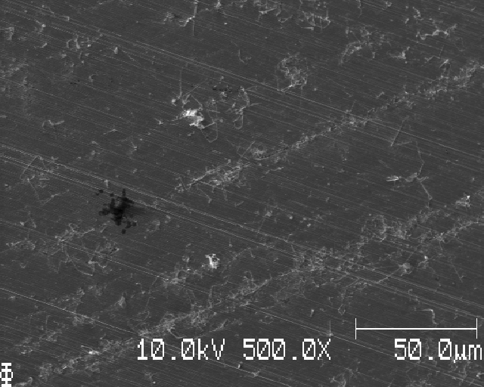
Deposition, closer to middle than edge

Slide 33
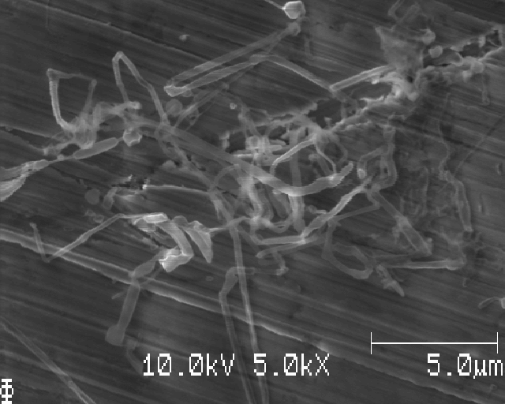

Slide 34
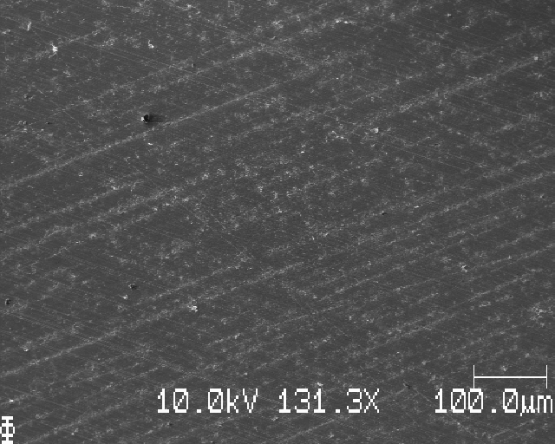
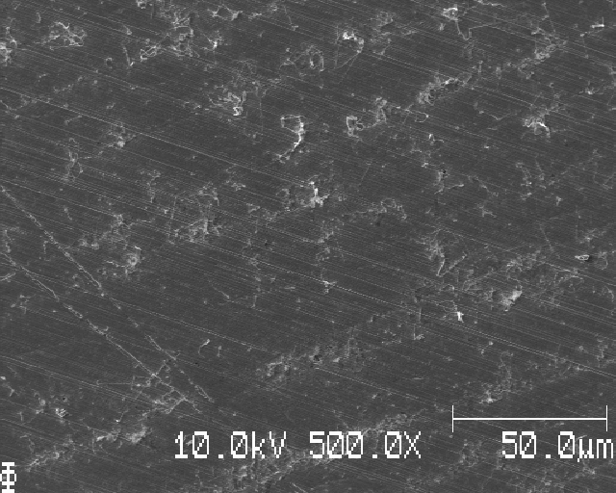
Another place; directional Li-deposition? Might be form the surface morphology from grinding?

Slide 35
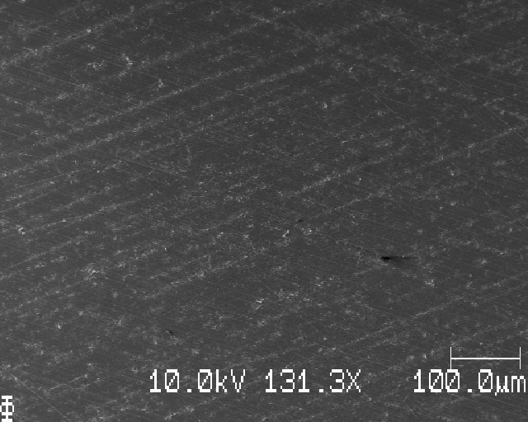
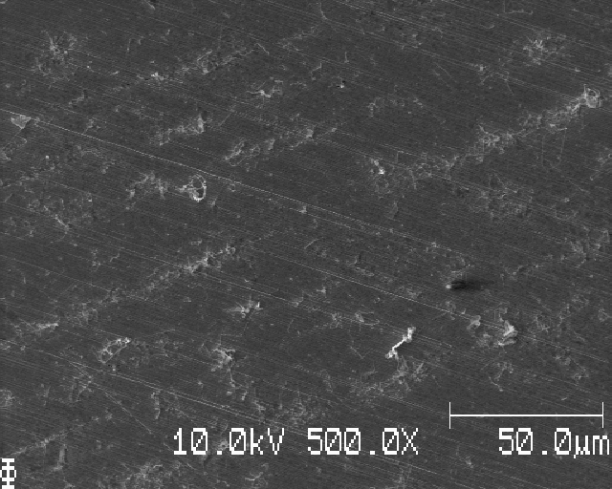
Another another place

Slide 36
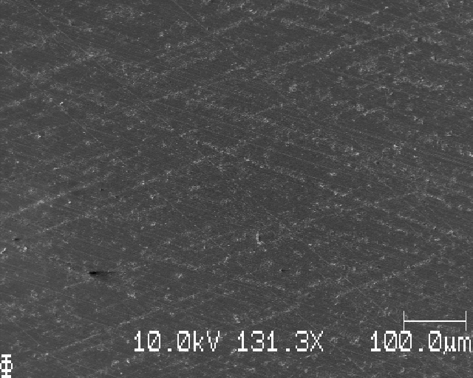

Directional in another direction

Slide 37



Slide 38



Directional: meeting Li deposition at different angles: probably from grinding

Slide 39

More directional

Slide 41
Sample Y

Slide 42


Different morphology

Slide 43


Looks like worms/caterpillars

Slide 44


But… further in we see more of the same deposition as in the other samples

Slide 45




Slide 46



Slide 47



Slide 49
Sample Z (less deposition than the others)

Slide 50


At edge

Slide 51


At top edge: no deposition

Slide 52



1mm down (toward middle): light parts are edge of the grinding lines? Note: dark spots

Slide 53


2mm down: very few particles of Li

Slide 54



3mm down

Slide 55



In the middle

Slide 56




Slide 57


Some deposition

Slide 58


Same place as before, small white particles

Slide 59

Wait! Maybe the light parts ARE Li after all one pic with grinding lines, very little white (N.P.)…

Slide 60


Moving just a little, we see white stuff in grinding lines (Li deposition)

Slide 61



Slide 62

VERY small Li nuclei?

